Slide 1
The Interwar Years
Unit 3 – Chapter 7
Pages 148 - 182

Slide 2
Key Terms
Economic Diversification – economic development that depends on a variety of industries rather than one industry
  Prior to WWI, NL depended entirely on the fishery. However by 1915, this fishery-based economy was struggling to support a growing population
  Developments in Mining, Forestry, and Agriculture helped to diversify the economy

Slide 3
Key Terms
Land-based Industry – resources of the land. End of WWI governments had to create new job opportunities and industries to employ growing population. They turned to resources of the land (mining, forestry, agriculture). This change caused people to move from the shoreline and to settle inland. Thus new towns grew up in the interior

Slide 4
Key Terms
Great Depression
  1930’s referred to as the ‘dirty thirties” because of economic hardship suffered by people worldwide
  Period of economic collapse
  Decrease in imports and exports in NL
  Debt $100 million

Slide 5
Key Terms
Commission of Government
  1934 NL government changed from elected Responsible government to an appointed commission
  People were no longer able to vote for own leaders
  In exchange for self-rule, Britain took responsibility for the NL debt and for paying for education, health and welfare
  Three Newfoundlanders were appointed to commission, no women, and no representation from Labrador

Slide 6
Activities
Complete the Handout on Land-Based Industries

Slide 7
Disaster and Crisis
Government and business make effort to increase employment and reduce poverty with development of Land-based Industries
Unexpected natural disaster and political and economic crisis make prosperity and progress impossible
These occurred in the form of
  The 1929 Tidal Wave
  The Great Depression – 1930’s
  The St. John’s Riot of 1932

Slide 8
The 1929 Tidal Wave
What were the effects of the 1929 tidal wave (tsunami) on southern Burin Peninsula communities ?
What was the response of people in these communities and people elsewhere to the disaster?

Slide 9
Background
On 18 November 1929 a tsunami strikes Newfoundland's Burin Peninsula and caused considerable loss of life and property.
Giant waves hit the coast at 40 km/hr, flooding dozens of communities and washing entire homes out to sea.
The disaster killed 27 people and left hundreds more homeless or destitute. It was the most destructive earthquake-related event in Newfoundland and Labrador's history

Slide 10
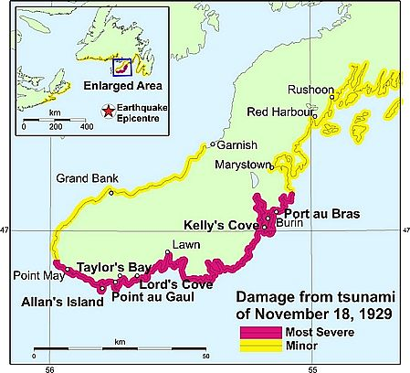
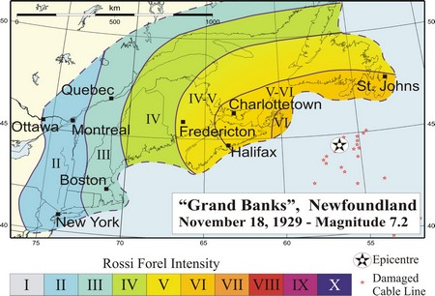
Extent of damage from the 1929 tsunami on Burin Peninsula, Newfoundland (modified from Whan, 1994). Village names in bold indicate where lives were lost.

Slide 11
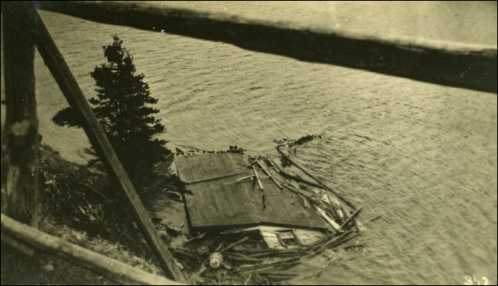
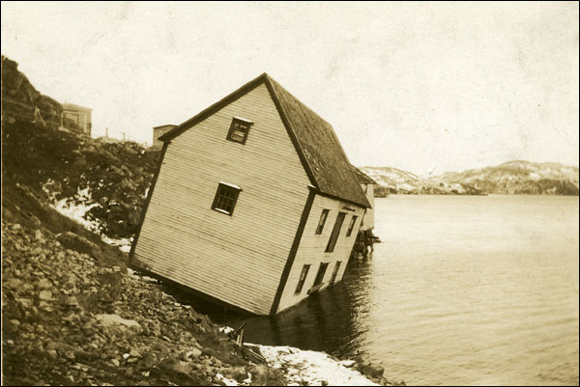
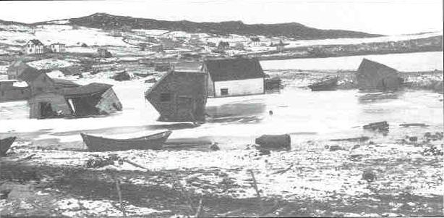
Pictures

Slide 12

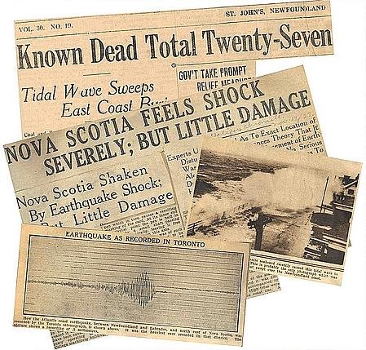

Slide 13
Effects
Tsunami moved at speed of 100km/h
Three main waves measuring 7-15 meters high rushed into towns along the coast
Waves destroyed schools, homes, and vessels and swept people into sea
Over 40 communities affected
Poor fish catches in years to follow attributed to damage to ocean floor by tidal wave

Slide 14
Response
A relief ship arrived at the Burin Peninsula the following day carrying medical equipment, food, clothes, and other supplies.
Public donations poured in from across the country, and within weeks amounted to $250,000.
Canada, the United States, and Britain also gave money and aid

Slide 15
Response
Prime Minister Sir Richard Squires dispatched the steamer SS Meigle to the Burin Peninsula with a cargo of medical supplies and personnel, government officials, food, clothing, construction materials, and other goods.
South Coast Disaster Committee established to coordinate fundraising and other relief efforts. Within weeks of its formation, the committee had collected $100,000 from St. John’s and $90,000 from Corner Brook, Grand Falls, and smaller settlements across the country

Slide 16
Response
Despite relief efforts, the following decade was a time of tremendous economic hardship for many communities along the Burin Peninsula
Show Video

Slide 17
The Great Depression
What was the Great Depression?
What conditions brought on the Great Depression?
What impact did the Great Depression have on working-class of NL
How effective were government attempts to deal with the Great Depression?

Slide 18
Definition
The Great Depression was a worldwide economic downturn that began in the fall of 1929 and did not end in many places until the Second World War.

Slide 19
What Caused it?
It was triggered in large part by a sudden crash of the American stock market on October 29, a day widely known as Black Tuesday.
Spending during the First World War had resulted in a large national debt, as did the costs of maintaining the Newfoundland Railway. The government also borrowed heavily throughout the 1920s to meet its expenses and a post-war slump in world trade further exacerbated the situation.

Slide 20
Impacts
Widespread Unemployment
  Fish prices declined; the price of a quintal (112 pounds) of dried cod fell from $9.00 to $4.53.
  businesses forced to lay-off employees
“The Dole” (a type of social assistance)
  Thousands out of work forced to go on government relief
  Amount family received depended on number of family members
  Family of 4 received $7.70 a month; family of 10, $17.00, not enough to feed most families
  “going on the dole” was considered a disgrace
  It is recorded that 60,000 Newfoundlanders were on able-bodied relief during the depression

Slide 21
Rations from NL Rangers Website
List of Rations a Person Would get for One Month
List of Rations a Person Would get for One Month
25 pounds of flour 1 quart of molasses 3 3/4 pounds of fat back pork 2 pounds of beans 1 pound of split peas 2 pounds of corn meal 3/4 pound of cocoa The entire ration order for the month would equal $1.80, or six cents a day.

Slide 22
Impacts
Growing discontent
  Harsh conditions of depression drove some people to unruly behavour through frustration and anger
  Residents in some communities broke into stores for food, (food riots) broke into government offices and organized demonstrations
  People would enter stores and demand basic necessities such as flour and sugar. Many people resorted to poaching of wildlife in order to feed themselves and their families. Horse meat and salmon became common meals in rural Newfoundland and may have helped people survive the depression.

Slide 23
St. John’s Riot of 1932
Event marked by anger and violence
People frustrated because of economic circumstances and allegations of government misuse and abuse of funds
Allegations of corruption were levied against the government of Sir Richard Squires
  Couldn’t live on amount of dole
  Squandering tax money
  Paying himself from public funds

Slide 24
April 5, 1932
Public demonstration outside the Colonial Building in St. John’s escalated into a riot numbering 10,000 people.
Police ordered to clear area
Protesters storm building and riot ensued
Several people injured, two police officers hospitalized, and building ransacked
Prime Minister Sir Richard Squires escaped from the building with a police escort, but was voted out of office in an ensuing election

Slide 25
Activity
Read Pages 162-183 and note:
The conditions and events that led to the loss of Responsible Government
Take a position as to whether the Commission of Government should have been established
Describe the impact of the loss of Responsible government on Newfoundland society
Explain whether or not the policies of the Commission of Government had a positive influence on Newfoundland and Labrador from 1934 to 1949.

Slide 26
Commission of Government
Page 169 - 173

Slide 27
The Facts
Rather than step down after riot, Sir Richard Squires calls general election for June 11, 1932
Party wins only 2 of 27 seats and Frederick Alderdice of United Newfoundland Party is elected Prime Minister
He now has to:
  Run a potentially bankrupt country
  Pay the interest on countries debt, requiring almost 2/3 of countries revenue

Slide 28
The Facts
Newfoundland considers defaulting on loans, but British government won’t allow it
They give the new government a loan in return for an agreement to appointment of a Royal Commission to investigate NL affaires
Report published by Lord Amulree, head of commission, on Oct. 4th, 1933

Slide 29
Amulree Report
Report finds local leaders incompetent and their irresponsibility has led to NL present situation
Recommends the suspension of self-government until country was self-supporting
This was approved by House of Assembly on December 2, 1933 resulting in end of Responsible Government and the beginning of Commission of Government

Slide 30
Impact
The people’s consent was not asked for, and there was very little opposition . In effect the government voted itself out of existence
79 years after winning a hard fought battle for responsible government, Newfoundland returned control of country to Britain in return for financial assistance
The Commission of Government appointed by Britain was led by a British governor, three British representatives, and three Newfoundland representatives
It would remain in effect for 15 years

Slide 31
Commission Policies
Pg. 174 - 183

Slide 32
Commission of Government
Broken down into six basic departments:
  Finance,
  Natural resources,
  Health and Welfare,
  Justice, Public Utilities, and
  Home Affairs & Education

Slide 33
The Newfoundland Ranger Force
created after the Commission of Government took over the government of Newfoundland
The Rangers had a similar format to the RCMP
Rangers were paid highly for their duties (http://www.ascension.k12.nf.ca/curriculum/social/nf_rangers/newfound.htm) by the standards of the day
may have caused some problems with the Rangers living in the communities where poverty and hunger were high

Slide 34
Activity
Read Pages 176-183 and answer the following questions
  Identify the main initiatives that Commission of Government undertook to improve conditions in NL.
  Describe the Commission of Government strategy to improve agriculture.
  What were educational conditions like during this period as compared to today
  Explain why good health care services were a challenge for the Commission of Government.
  Describe the role of NONIA and Grenfell Health in improving the quality of health in outport NL

Slide 35
Commission Policies
The commission was answerable to Dominion office in London
Had authority to act without consent of people of NL
NL’s were unable to vote for their leaders and had no control over taxation, spending of public money, or enactment of laws
Was not a democratic government
However it did try to respond to the needs of NL’s

Slide 36
Commission Policies
Land Settlement Scheme
  Designed to create farming communities and settle unemployment on the land
  Implemented in Markland in 1932 7 other communities
  To qualify, families had to have: 1 adult male working, receiving government relief
1934 – 1942, 365 families relocated
Was expensive and controversial
Did not take into account the emotional impact, loneliness of living in isolated areas
Considered to be more of a labour camp than a community

Slide 37
Commission Policies
Education
  Commission wanted more control over education (ie. More trained teachers, well-equipped schools)
  1943 – free and compulsory education introduced
  1949 – number of schools doubled
New curriculum with emphasis on health, social education and industrial training

Slide 38
Commission Policies
Health
  Main priorities were to fight disease, improve childhood immunization and provide diet supplements
  Set up Dept. of Health and Welfare and a network of Cottage Hospitals throughout the country
Floating hospital ship served many outport communities
Rural District Nursing Service expanded fro 8 to 54 nurses

Slide 39
Commission Policies
Law Enforcement
  Ranger Force established in 1935
  Replaced by RCMP in 1950
  Responsible for all policing outside the city of St. John’s

